Slide 1
Explainable AI for Predicting Early Parkinson's Disease using Voice Data and Handwriting Images
Mentor : Dr . Tapan Chowdhury
Submitted by
Jeet Shee (13000222009)
Soumyadip Adhikary (13000122079)
Aditya Dey (13000123127)
Ananya Das (13000122108)

Slide 2
Problem Statement
Parkinson’s Disease (PD) is a progressive neurological disorder that is difficult to detect accurately in early stages using a single clinical test.
Traditional diagnosis relies heavily on subjective clinical observation, leading to late detection and variability in diagnosis.
There is a need for an objective, automated, and multi-modal diagnostic system that can analyze motor and speech-related biomarkers.
Existing systems often lack interpretability, making it hard for clinicians to trust and understand model predictions.
This project aims to develop a multi-pipeline deep learning–based Parkinson’s Disease prediction system using:
Handwritten spiral images and wave images.
Voice data converted to spectrogram images.
The system integrates Explainable AI (Grad-CAM) to visually justify predictions, improving transparency and clinical reliability.

Slide 3
Objective
To develop an automated Parkinson’s Disease prediction system using multi-modal data.
To classify subjects as Healthy or Parkinson Affected using:
Handwritten Spiral Images for motor control analysis
Handwritten Wave Images for tremor and movement pattern analysis
Voice Data converted into spectrogram images
To apply deep learning–based CNN models:
VGG16 convolutional layers for feature extraction from spiral and wave images
InceptionV3 convolutional base for feature extraction from voice spectrograms
To improve diagnostic reliability through image-based and speech-based biomarkers.
To incorporate Explainable AI (Grad-CAM) to visually interpret and justify model predictions.

Slide 4
Literature Survey
Sl No | Page Title | Name of Journal | Year | Dataset Source | Method Used | Outcome | Research Gap
1 | Deep Learning Models for Predicting Cognitive Impairment in Parkinson's Disease Detection | ResearchGate | 2024 | UCI Machine Learning Repository | CNN , Genetic Algo and ReliefF Algo for Feature Selection | The outcomes show that the proposed strategy is successful in differentiating between people in good health and those with Parkinson's disease with accuracy of 93.29% is obtained in the absence of feature selection, and increases to 97.62% with the use of genetic algorithms for feature selection | should investigate the use of hybrid models that combine Self Attention CNN and Transformer.
2 | A machine learning method to process voice samples for identification of Parkinson’s disease | scientific reports | 2023 | https://doi.org/10.6084/m9.figshare.23849127 | Incception v3(CNN), Random forest, Logistic Regression, LPC, LAR, MFCC, CEP for spectral features | The study showed that voice recordings collected over regular phone calls ca be used to detect disease, This proves low cost, remote voice analysis, in early and realiable detection of disease. | No Implementation on handwritten data and and no Explainable AI usages .
3 | EXPLAINABLE ARTIFICIAL INTELLIGENCE TO DIAGNOSE EARLY PARKINSON’S DISEASE VIA VOICE ANALYSIS | scientific reports | 2024 | https://doi.org/10.6084/m9.figshare.23849127 | MLP, CNN, RNN, MKL, STFT, SHAP, Random Forest, K-fold cross validation | champion model yielded the following results: diagnostic accuracy of 91.11%, recall of 92.50%, precision of 89.84%, an F1 score of 0.9113, and an area under curve (AUC) of 0.9125. Furthermore, the use of (SHAP) detailed insight into the model’s decision-making process, highlighting the most influential features contributing to a PD diagnosis | No Research Work With Grad CAM and also No Usage of Explainable AI on Handwritten Data,

Slide 5
Literature Survey
Sl No | Page Title | Name of Journal | Year | Dataset Source | Method Used | Outcome | Research Gap
4 | Early Detection of Parkinson‟s Disease Using Convolutional Neural Networks on Handwritten Patterns | ResearchGate | 2024 | Faculty of Medicine of Botucatu, Sao Paulo State University, Brazil | CNN | MEANDER PATTERN:Gained an average accuracy of 88% by training the model with 35 epochs using the pattern “meander” from HandPD dataset SPIRAL PATTERN: We gained an average accuracy of 90% | No Work On Voice Data and No Explainable AI Implementation
5 | Classification of Parkinson Disease Based on Patient’s Voice Signal Using Machine Learning | Intelligent Automation & Soft Computing | 2022 | Voice dataset from 31 individuals (23 with Parkinson’s, 8 healthy). | SGD classifier, XG boost, Logistic Regression ,Random forest, KNN,Decision Tree as ML CLASSIFIER | The Random Forest Classifier gave the highest accuracy: 97.1%,KNN 95.4%,DECISION TREE:95.8%,XGBOOST 95%,LOGISTIC REGRESSION 91.6%,SGD:91.6% | No Deep LLearning Based Methods Used or No Work on Handwritten based Data.
6 | Voice analysis in Parkinson’s disease - a systematic literature review | Artificial Intelligence in Medicine (elsevier) | 2025 | UCI Parkinson’s Datasets, PC-GITA Dataset, MDVR-KCL Dataset, mPower Dataset, PPMI Dataset, Neurovoz Dataset, GYENNO Datase | -PRISMA Guidelines -Rayyan Tool -Voice Activity Detection (VAD) -PCA (Principal Component Analysis) -Relief Algorithm -Genetic Algorithm -ANOVA -SVM (Support Vector Machine) -Random Forest (RF) -K-Nearest Neighbors (KNN) -Decision Tree (DT) -CNN (Convolutional Neural Network) -LSTM (Long Short-Term Memory) | -94% of studies aimed at detecting Parkinson’s. -Only 11% worked on predicting how the disease might progress (prognosis). -More research is needed on prognosis. -Most studies showed high accuracy (often above 90%) in diagnosing Parkinson’s using voice features. | No work on Handwritten data and No Explainable AI Usage

Slide 6
Literature Survey
Sl No | Page Title | Name of Journal | Year | Dataset Source | Method Used | Outcome | Research Gap
7 | Parkinson's Detection Based On Combined CNN And LSTM Using Enhanced Speech Signals With Variational Mode Decomposition | ResearchSquare | 2021 | PC-GITA Spanish Dataset | 1.Preprocessing: 1. Denoising with VMD 2. Mel-Spectogram Extraction 3. Combined use of ResNet-LSTM Network | The highest classification performance is obtained from the ResNet-101 + LSTM model with VMD as 98.61%. The comparison of the proposed model with the state of the art of models demonstrates model's efficacy in PD detection. | No Work on Handwritten data or no usage of Explainable AI Technology
8 | Prediction of Parkinson’s Disease using Handwriting Analysis and Voice DatasetA Review | ResearchGate | 2024 | The UCI machine learning repositories contain the following datasets: Parkinson's Disease Voice and Speech, PPMI, and the Parkinson's Telemonitoring dataset. | Spiral Dataset: VGG16-CNN, k-Nearest Neighbors classifier, and logistic regressionclassifier. • Voice Dataset: techniques for pattern identification and fuzzy c-means (FCM) clustering. | Comparison Between Existing Methodologies and Using Similar ML and DL Approaches for both Handwriting and Voice data.. | NO New Methods Proposal Outside Existing methods. Only Work On Both Voice and Handwriting data
9 | Predicting Parkinson’s Disease Using Machine Learning with Voice Parameters and Handwriting Image | JOURNAL OF DATA SCIENCE | 2024 | Dataset for Handwriting Images: The dataset is collected from Kaggle,Dataset for Voice:created by Max Little University of Oxford, in partnership with the National Centre for Voice and Speech | Feature Extraction and Selection from Image and Voice data . Then Model Development involves employing machine learning algorithms like Support Vector Machines (SVM), Random Forests, or Linear Regression models and then selecting the best one that gives the highest accuracy | The results showed that the model attained an accuracy of 98%. | No Usage of Deep Learning Based models and No usage of Explainable AI Technologies for Explainability of the outcomes

Slide 7
Research Gaps
Existing Parkinson’s Disease prediction systems often rely on single-modal data, such as only voice or only handwriting.
Many studies use traditional Machine Learning techniques, limiting feature representation and performance.
Some Deep Learning–based approaches focus only on spiral drawings, ignoring other handwritten patterns like wave drawings.
Very few works integrate both handwriting (spiral + wave) and voice data in a unified framework.
Most Deep Learning models act as black-box systems, lacking interpretability.
Explainable AI is rarely applied, and when used, it is limited to voice data only.
No comprehensive system exists that applies Explainable AI across all data pipelines

Slide 8
Proposed Work-Novel Contribution
Development of a multi-modal Deep Learning–based framework for Parkinson’s Disease prediction utilizing:
Handwritten Spiral Images
Handwritten Wave Images
Voice-derived Spectrogram Images
Adoption of transfer learning–based Convolutional Neural Networks (CNNs) for robust feature extraction.
Design and training of a custom classification architecture tailored to the proposed dataset.
Integration of Explainable Artificial Intelligence (XAI) using Grad-CAM across all three pipelines.
Generation of visual explanations to highlight discriminative regions influencing model predictions.
Enhancement of model transparency, interpretability, and clinical reliability.
Presentation of the first unified approach combining handwriting and voice modalities with Explainable AI applied consistently across all pipelines.

Slide 9
Project Flow
Input Data Acquisition
Handwritten Spiral Images
Handwritten Wave Images
Voice Recordings
Data Preprocessing
Image Resizing and normalization
Noise removal and standardization
Conversion of Voice Signals into spectrogram images
Feature Extraction
Spiral and Wave Images Pipeline
VGG16 convolutional backbone
Voice Pipleline
InceptionV3
backbone
Improved Interpretability and Diagnostinc Transparency
Final Output
Predicted Class Label (Parkinson Affected / Healthy )
Corresponding Grad-CAM visual Explanation
Explainable AI Integration
Application of Grad-CAM on each Pipeline
Generatoion of Activation heatmaps
Critival Regions Influencing Activations.

Slide 10
Methods Used
Datasets Used:
Voice Dataset
Voice Samples for Patients with Parkinson’s Disease and Healthy Controls
Source: Figshare
Contains voice recordings of Parkinson’s patients and healthy subjects
Used for speech-based Parkinson’s Disease analysis
Link:
https://figshare.com/articles/dataset/Voice_Samples_for_Patients_with_Parkinson_s_Disease_and_Healthy_Controls/23849127
Handwriting Dataset
Parkinson’s Augmented Handwriting Dataset
Source: Kaggle
Includes handwritten spiral and wave drawings
Used to analyze motor control and tremor patterns
Link:
https://www.kaggle.com/datasets/sowmyabarla/parkinsons-augmented-handwriting-dataset

Slide 11
Methods Used
Deep Learning Models Used:
VGG16
A deep Convolutional Neural Network with 16 layers
Known for effective image feature extraction
Used as a pre-trained convolutional backbone for:
Handwritten spiral images
Handwritten wave images
InceptionV3
A deep CNN architecture optimized for complex image representations
Uses multi-scale convolution filters for improved feature learning
Used as a pre-trained convolutional backbone for:
Voice spectrogram images
Transfer Learning Approach
Pre-trained convolutional layers are reused
A custom classification network is trained on the project-specific datasets

Slide 12
Methods Used
Explainable Artificial Intelligence Method:
Explainable AI refers to techniques that make machine learning model decisions understandable to humans.
It helps explain why a model made a particular prediction, instead of acting like a black box.
XAI improves trust, transparency, and reliability, especially in critical domains like healthcare and finance.
Grad-CAM (Gradient-weighted Class Activation Mapping)
An Explainable AI technique for CNN-based models
Uses gradient information to identify important regions influencing predictions
Produces visual heatmaps over input images
Applied to:
Handwritten spiral pipeline
Handwritten wave pipeline
Voice spectrogram pipeline

Slide 13
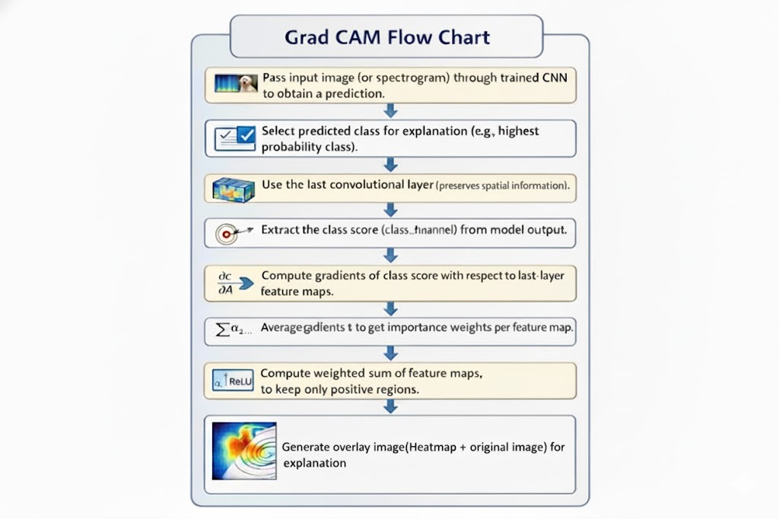
How Grad CAM works
Explanation
The input image (or spectrogram) is passed through a trained CNN to obtain a class prediction.
The predicted class is selected, and the last convolutional layer is used since it preserves spatial information.
Gradients of the selected class score are computed with respect to the last-layer feature maps.
These gradients are averaged to obtain importance weights, which are used to compute a weighted sum of feature maps.
The resulting heatmap is overlaid on the original image, highlighting regions that influenced the model’s decision.

Slide 14
Parkinson’s Disease Detection Using Handwritten Spiral and Wave Image Analysis

Slide 15
Motivation Behind Choosing Handwritten Spiral & Wave Analysis
• Handwriting Is Early Affected in Parkinson’s Disease
○ Motor symptoms such as tremor and rigidity appear early in handwriting
○ Spiral and wave drawings amplify fine motor abnormalities
• Clinically Accepted Screening Test
○ Spiral and wave drawing tests are commonly used by neurologists
○ Reflect real motor impairment, not subjective symptoms
• Non-Invasive and Patient-Friendly
○ No medication, needles, or scanning devices required
○ Minimal physical and mental stress for patients
• Easy and Low-Cost Data Collection
○ Requires only pen-and-paper or digital tablet
○ Can be collected in clinics or at home
• Suitable for Automated Image-Based Analysis
○ Handwriting patterns can be effectively learned by CNNs
○ Works well with transfer learning models like VGG16

Slide 16
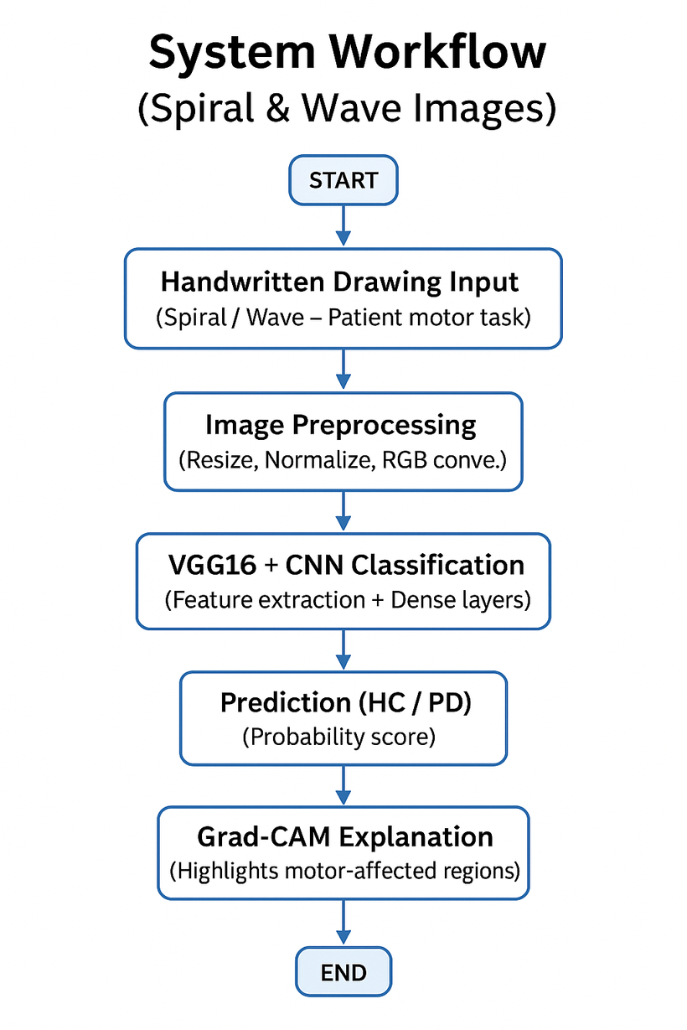
Workflow Explanation
• The system accepts handwritten spiral or wave drawings as input
• Images are preprocessed to standardize size and intensity
• VGG16-based transfer learning extracts discriminative motor features
• CNN classifier predicts Healthy Control (HC) or Parkinson’s Disease (PD)
• Grad-CAM highlights regions influencing the prediction

Slide 17
Image Preprocessing
Resizing
• Handwritten images come in different resolutions
• CNNs require a fixed input size
• All images are resized to a uniform dimension (e.g., 128×128)
• Ensures consistent feature extraction across samples
Normalization
• Raw pixel values range from 0 to 255
• Values are scaled to 0–1
• Prevents dominance of large pixel values
• Improves training stability and faster convergence
RGB Conversion
• VGG16 is pretrained on ImageNet RGB images
• Input must have 3 color channels
• Grayscale drawings are converted to RGB format
• Preserves compatibility with pretrained weights
Why Preprocessing Is Important
• Reduces noise and variability
• Improves model generalization

Slide 18
VGG16 + CNN Classification
VGG16 Feature Extraction
• VGG16 is a deep convolutional neural network pretrained on ImageNet
• Learns low-level (edges, curves) and high-level (shape distortions) features
• Effectively captures tremor-induced irregularities in handwriting
Transfer Learning Strategy
• Pretrained weights are reused instead of training from scratch
• Requires less data and computation
• Reduces overfitting on limited medical datasets
• Enables faster and more stable convergence
CNN Classification Head
• Extracted features are passed to Dense layers
• Learns Parkinson’s-specific motor patterns
• Dropout improves generalization
• Sigmoid activation outputs HC / PD probability
Why VGG16 Works Well Here
• Strong at capturing fine structural variations
• Suitable for medical image analysis with limited data

Slide 19
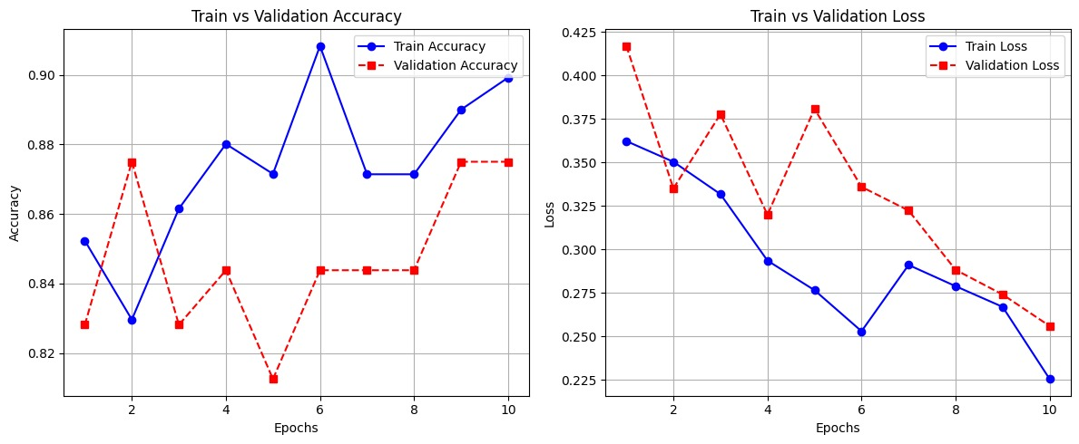
Train Test Accuracy Loss Graph

Slide 20
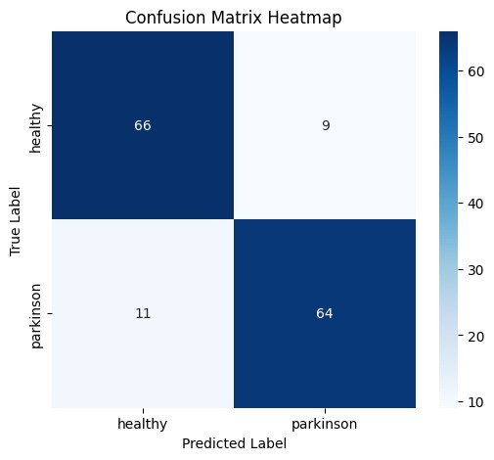
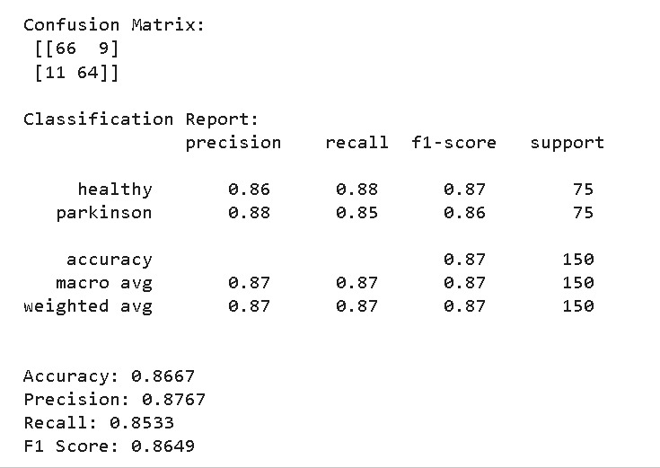
Model Evaluation for Spiral Image

Slide 21
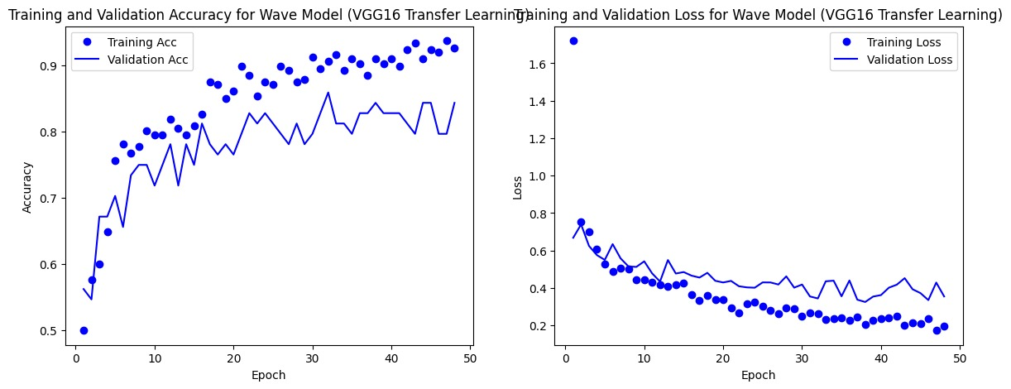
Train Test Accuracy Loss Graph for Wave Image

Slide 22
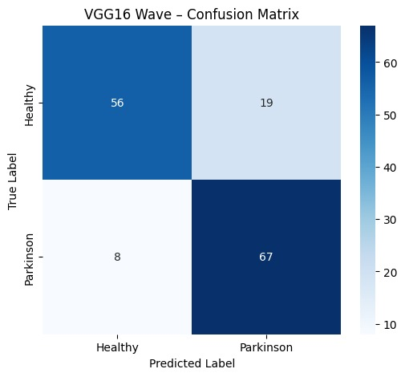
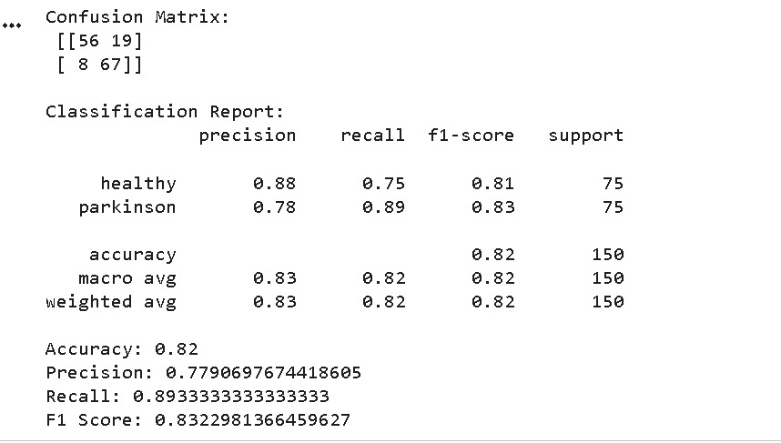
Model Evaluation for Wave Image

Slide 23
Prediction (HC / PD)
Probability-Based Output
• The trained model produces a probability score for Parkinson’s Disease
• Score reflects the confidence level of the prediction
Final Classification
• Based on a predefined threshold, the input is classified as:
– Healthy Control (HC)
– Parkinson’s Disease (PD)
• Ensures consistent and reproducible decisions
Automated & Objective Decision
• Eliminates subjective manual assessment
• Provides fast and repeatable predictions
• Suitable for computer-aided clinical screening
Why This Step Is Important
• Converts learned features into a clinically interpretable outcome
• Supports early detection and decision support

Slide 24
Grad-CAM Explanation
Visual Heatmap Generation
• Grad-CAM generates class-specific heatmaps over the input image
• Uses gradients from the final convolutional layer
• Shows which regions influenced the model’s decision
Motor Pattern Localization
• Highlights irregular curves, tremor zones, and distortions
• Focuses on regions affected by motor impairment
• Confirms the model is learning clinically relevant features
Model Interpretability
• Makes the CNN decision transparent and explainable
• Reduces “black-box” behavior
• Builds clinical trust in automated predictions
Why Grad-CAM Matters
• Helps validate correct model attention
• Supports reliable medical decision-making
• Essential for explainable AI in healthcare

Slide 25
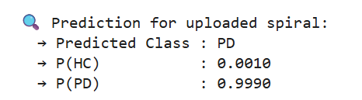
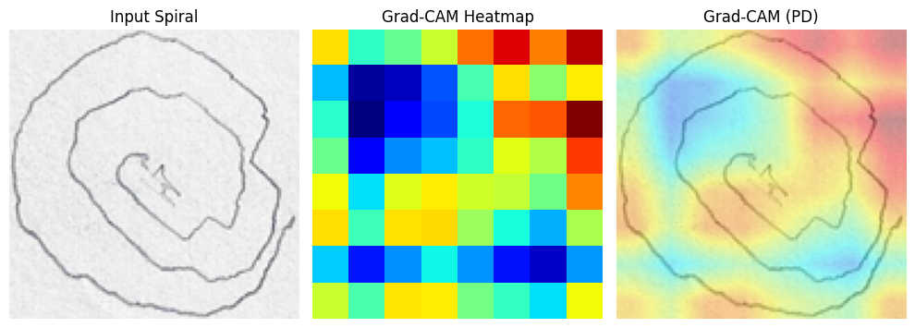
Grad CAM Interpretation for Spiral Images

Slide 26
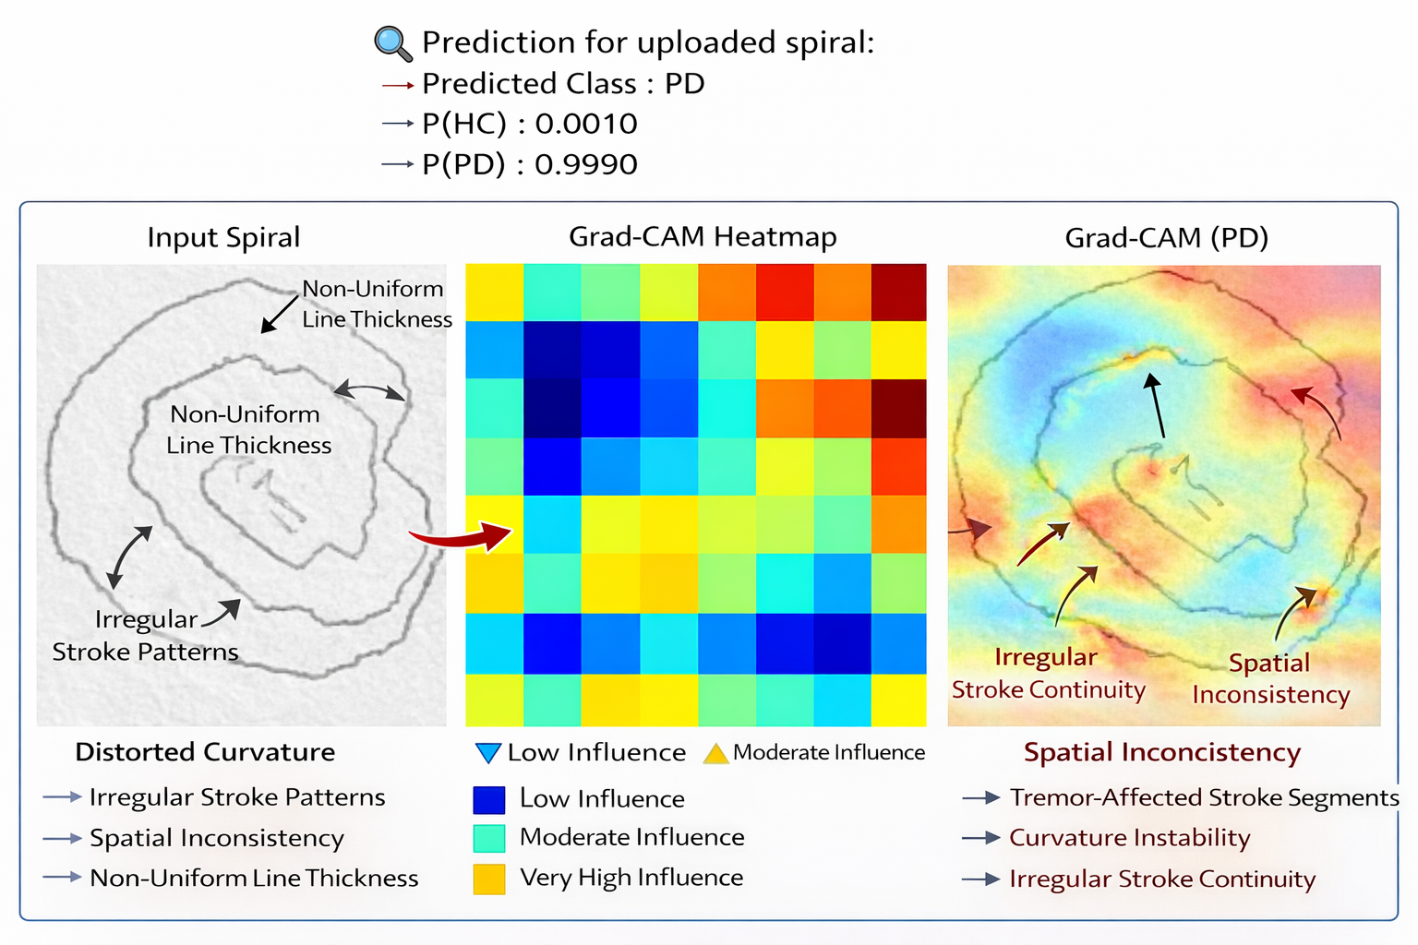
Grad CAM Interpretation for Spiral Images

Slide 27
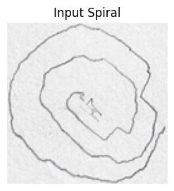
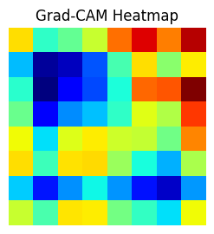
Grad CAM Interpretation for Spiral Images
Input Spiral (Raw Handwriting Image)
Observations from the Input Spiral:
The spiral is not smooth or uniform.
Visible irregular stroke patterns along the spiral path.
Non-uniform line thickness, indicating unstable pen pressure.
Distorted curvature, where the spiral deviates from a consistent circular shape.
Clinical Interpretation:
These abnormalities are commonly associated with tremor and impaired fine motor control in Parkinson’s Disease.
Grad-CAM Heatmap (Model Attention Map)
What this heatmap shows:
The heatmap represents regions the CNN focused on when predicting PD.
Colors indicate influence on the PD prediction:
🔵 Blue → Low influence
🟢 Green → Moderate influence
🔴 Yellow/Red → Very high influence
Key Insight:
The attention is structured and localized, not random, indicating meaningful feature learning.

Slide 28
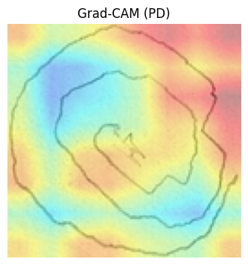
Grad CAM Interpretation for Spiral Images
Grad-CAM Overlay (PD Explanation)
Highlighted Regions Indicate:
Irregular stroke continuity caused by tremor.
Curvature instability, showing difficulty in maintaining smooth motion.
Spatial inconsistency, such as uneven spacing between spiral loops.
Tremor-affected stroke segments, strongly emphasized by the model.
Why this matters:
The model focuses on clinically relevant handwriting abnormalities.
Why the Model Predicts PD with High Confidence
Multiple Parkinson’s-related features appear simultaneously:
Tremor-induced irregular strokes
Inconsistent curvature
Non-uniform spatial spacing
These features closely match patterns learned from PD samples during training.
Very few characteristics resemble healthy spiral patterns.
➡️ This explains the very high PD probability (0.9990).

Slide 29
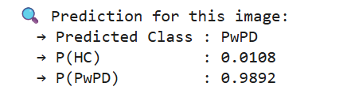
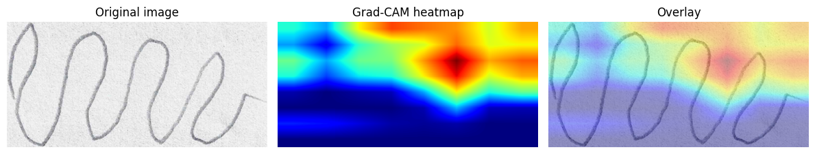
Grad CAM Explanation for Wave Images

Slide 30
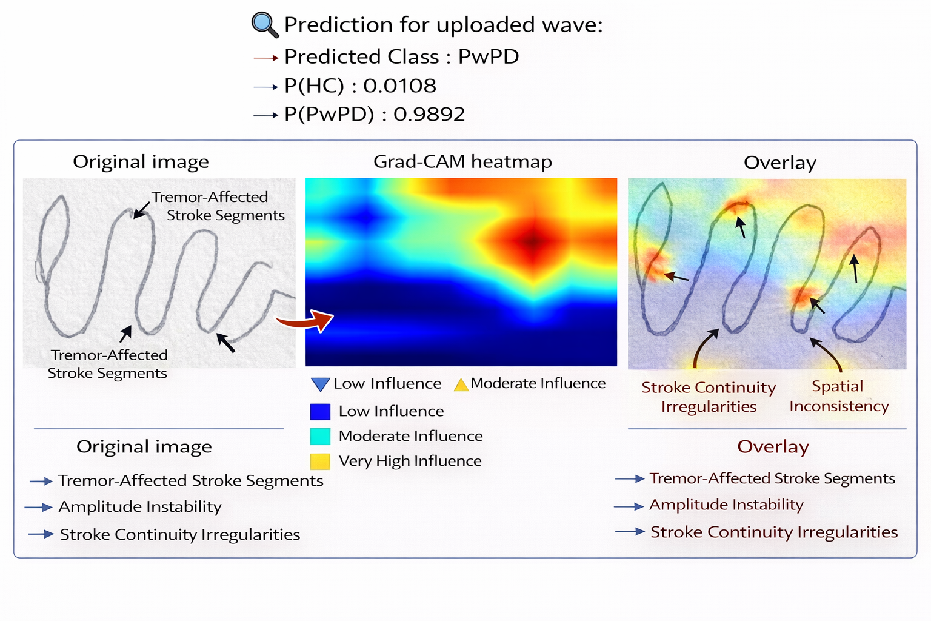
Grad CAM Explanation for Wave Images

Slide 31
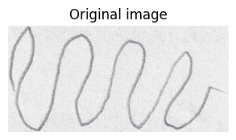
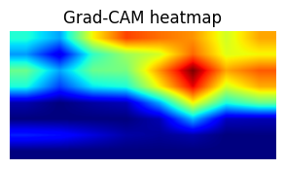
Grad CAM Explanation for Wave Images
Original Image
Shows the raw wave drawing created by the subject.
Visible tremor-affected stroke segments are highlighted.
Noticeable amplitude instability in wave peaks and troughs.
These irregularities are common motor symptoms in Parkinson’s disease.
Grad-CAM Heatmap
Displays regions the deep learning model focused on for prediction.
Blue areas → low influence on the decision.
Green/Yellow areas → moderate to very high influence.
High-influence regions align with irregular wave patterns and unstable strokes.

Slide 32
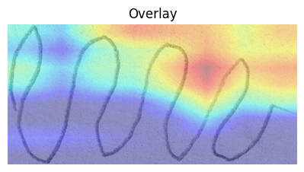
Grad CAM Explanation for Wave Images
Overlay Visualization
Combines the original image with the Grad-CAM heatmap.
Red and yellow regions indicate areas most responsible for PwPD prediction.
Arrows point to:
Tremor-affected stroke segments
Stroke continuity irregularities
Spatial inconsistency in wave formation
Why the Model Is Highly Confident
Strong tremor-related stroke irregularities are consistently detected across the wave pattern.
The Grad-CAM heatmap shows high activation on clinically relevant regions used for decision-making.
Clear amplitude instability and stroke discontinuity match learned PwPD features.
Very low probability for HC indicates minimal overlap with healthy handwriting patterns.

Slide 33
Parkinsons Disease Detection via Voice Analysis

Slide 34
Motivation behind choosing Voice
Voice is Early Affected in Parkinson’s Disease
~90% of PD patients develop voice/speech abnormalities (hypophonia, tremor, monotone speech)
Voice Collection is Non-Invasive
No needles and scanning machines
No physical stress to patient
Voice Data is Easy & Low-Cost to Collect
Requires only:
Microphone
Can be recorded:
At home
In clinics
Voice Enables Remote & Continuous Monitoring
Works Very Well with Deep Learning

Slide 35
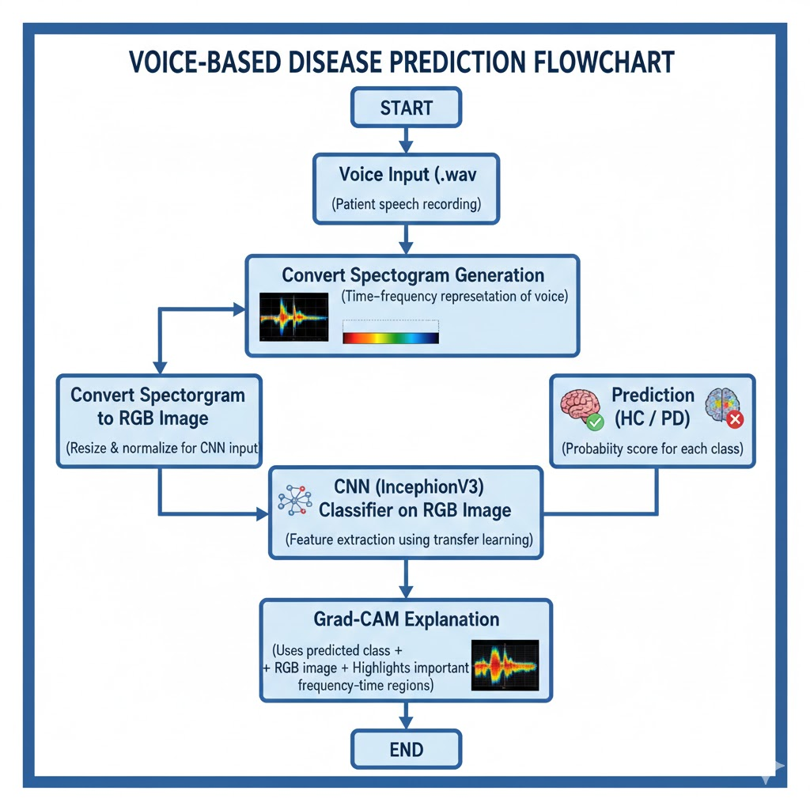
System Workflow

Slide 36
Voice to Spectrogram
Goal: Compute a dB-scaled spectrogram from an audio signal.
Library: Relies on the librosa library for audio processing functions.
Configuration: Uses specific parameters: 8000 Hz sampling rate, 32ms window, 50% overlap, and a 1024-point FFT.
STFT: Performs the Short-Time Fourier Transform (STFT) with a Hann window to analyze time-frequency content.
Magnitude: Converts the complex STFT output to the magnitude spectrogram.
Scaling: The magnitude is normalized and then transformed into the decibel (dB) scale.
Result: The function returns the dB-spectrogram matrix ready for analysis.

Slide 37
Spectrogram to Image Conversion
Goal: Convert a 2D numerical spectrogram matrix (in dB) into standard image formats.
Tools: Uses the Python Imaging Library (PIL) for image manipulation (resizing, color conversion).
Input: Accepts the dB-scaled spectrogram (S_db) and a target image size (default 600 X 600).
Normalization: The S_db matrix is linearly scaled from its minimum and maximum values to the 0-255 integer range (uint8).
Grayscale Image: The normalized data is created as a PIL Grayscale image (mode="L").
Resizing: The grayscale image is resized to the target dimensions using BICUBIC resampling for quality.
RGB Conversion: A 3-channel RGB image is created by simply converting the grayscale image.
Output: Returns two NumPy arrays: the RGB image (H X W X 3) and the Grayscale image (H X W).

Slide 38
InceptionV3 CNN – Overview
InceptionV3 is a deep convolutional neural network developed by Google for high-accuracy image classification
Uses Inception modules with parallel filters (1×1, 3×3, 5×5) to capture multi-scale features
1×1 convolutions reduce dimensionality and computational cost
Pretrained on ImageNet, enabling effective transfer learning for small datasets
Produces rich spatial feature maps, suitable for medical image analysis
Efficient architecture with batch normalization for faster and stable training
Well-suited for RGB spectrogram images derived from voice signals
Supports Grad-CAM explainability by preserving spatial information
Used for binary classification (HC vs PD) with custom dense layers

Slide 39
Freeze & Unfreeze InceptionV3
Freezing (Feature Extraction)
Pretrained InceptionV3 weights are kept fixed
Learns generic visual features (edges, textures)
Prevents overfitting on small medical datasets
Only custom dense layers are trained
Enables fast and stable training
Unfreezing (Fine-Tuning)
Selected top layers are made trainable
Adapts features to Parkinson’s voice spectrograms
Helps learn disease-specific patterns
Uses very low learning rate to avoid distortion
Improves final model accuracy

Slide 40
why we have used freezing in InceptionV3 for Parkinson’s Disease (PD) detection ?
Parkinson’s voice datasets (HC: 41 and PD : 40) are small, and training the full InceptionV3 would cause overfitting
Pretrained InceptionV3 already learns robust visual features (edges, textures) from ImageNet
Voice spectrograms contain similar visual patterns, making transfer learning effective
Freezing allows InceptionV3 to act as a fixed feature extractor
Training focuses only on PD vs HC classification layers
Results in faster, stable training with fewer parameters
Produces consistent feature maps, improving Grad-CAM explainability
Follows medical AI best practices for limited data scenarios

Slide 41
\
Training in InceptionV3
RGB spectrogram images are provided as input to the CNN
Base InceptionV3 layers are frozen during initial training
A custom classification head (Dense + Dropout) is added
Only the new layers are trained to classify HC vs PD
Training uses the Adam optimizer with sparse categorical cross-entropy loss
Batch normalization and dropout improve training stability and reduce overfitting

Slide 42
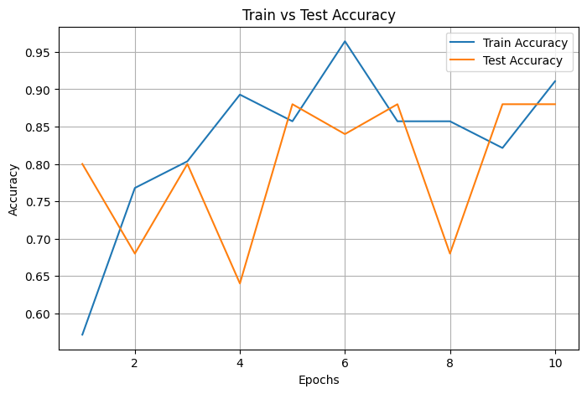
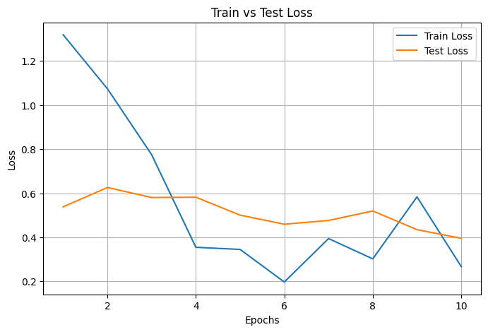
Train-Test Accuracy-Loss Graph

Slide 43
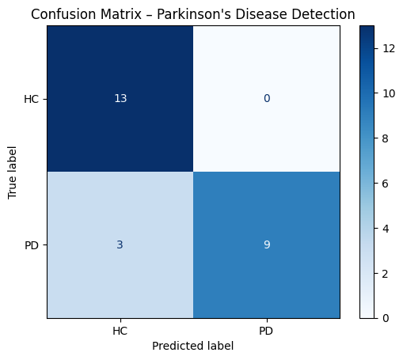
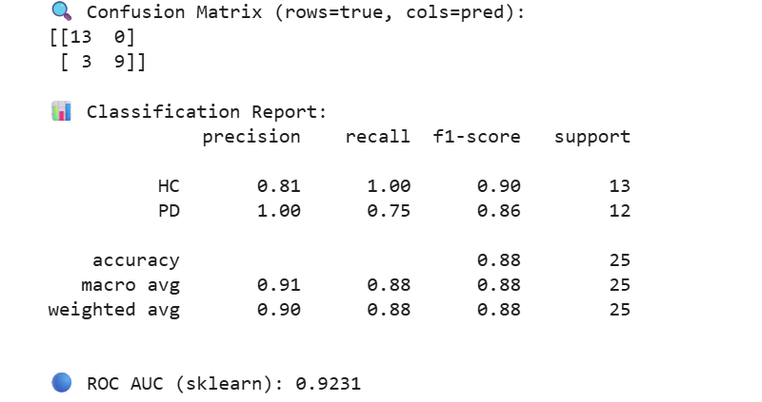
Model Evaluation

Slide 44
Prediction Phase
Convert Spectrogram to RGB image
Voice Input (eg. .wav file)
Spectrogram Generation
Output will be the class with high probability
Prediction (HC / PD)
CNN (InceptionV3) classifier on RGB images

Slide 45
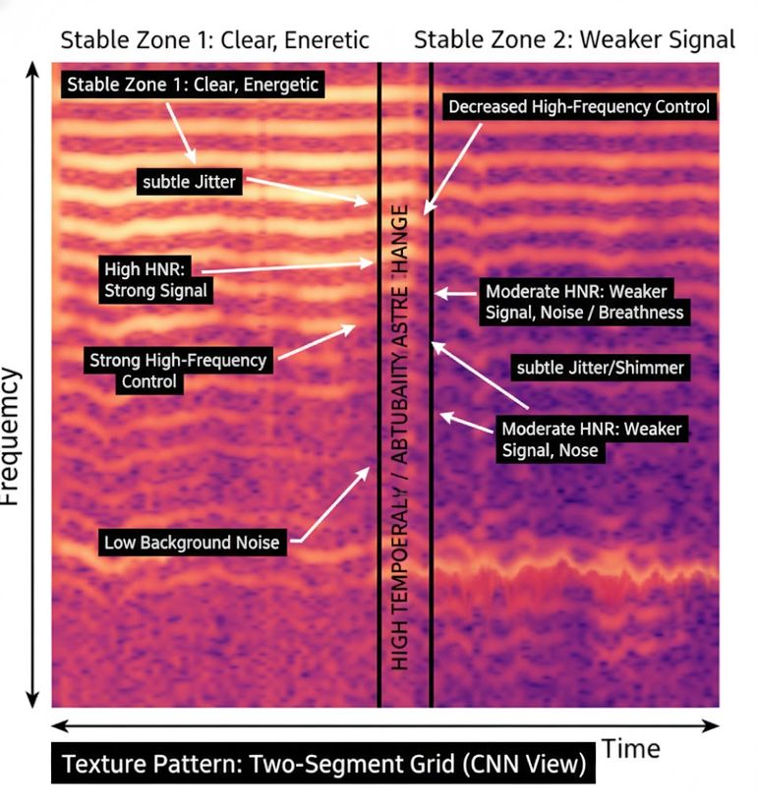
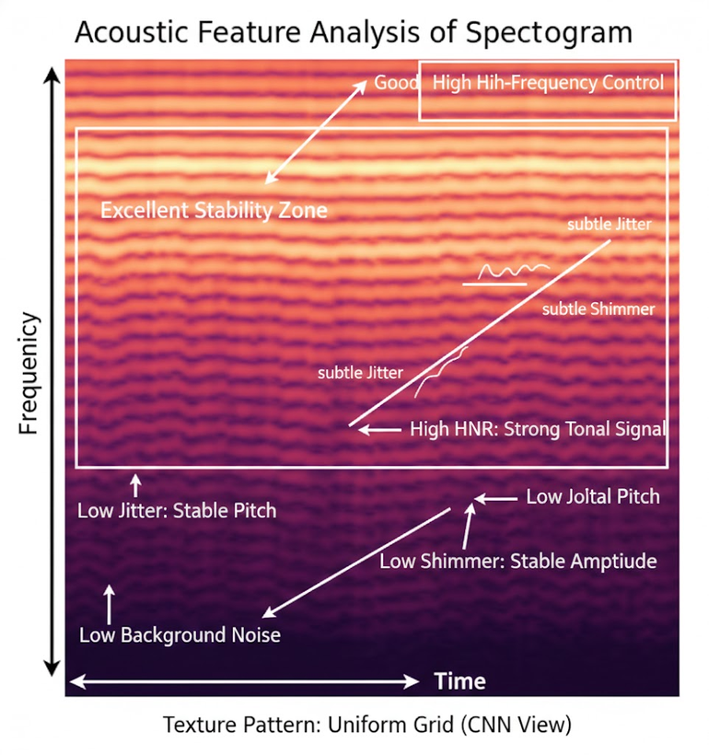
Comparitive Analysis Between PD vs HC Spectogram
Fig: Spectrogram 1
Fig: Spectrogram 2

Slide 46
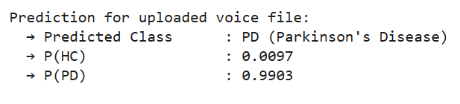
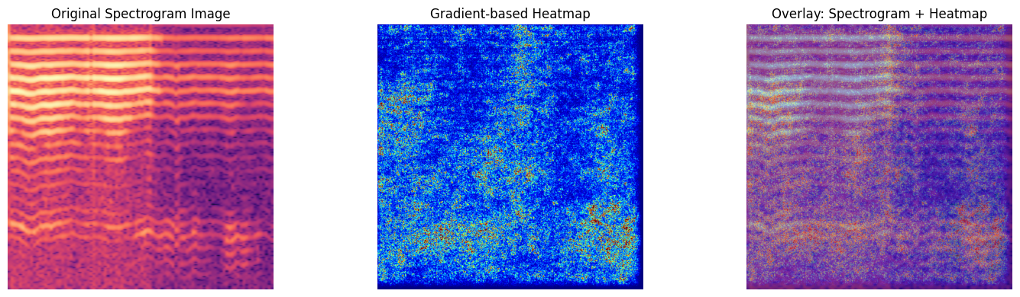
Grad CAM Interpretation

Slide 47
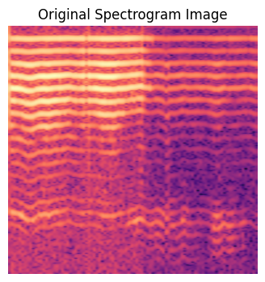
Original Spectrogram Analysis
Represents time–frequency characteristics of the voice signal
X-axis: Time
Y-axis: Frequency
Color intensity: Signal energy
A trained human suspects pathology here but cannot quantify confidence
Observed abnormalities:
Irregular and broken harmonic bands
Reduced harmonic clarity
Increased noise in mid and high frequencies
Clinical relevance:
Indicates vocal instability
Common in Parkinson’s speech due to motor control impairment

Slide 48
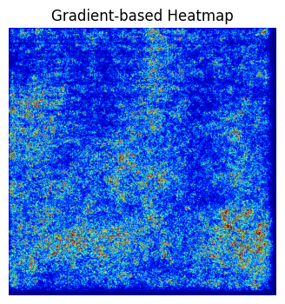
Gradient-Based Heatmap (XAI)
Visualizes important regions used by the CNN for prediction
Computed using gradient-based explainability (Grad-CAM style)
Color interpretation:
🔵 Blue → low importance
🟡 Yellow → medium importance
🔴 Red → high importance
Key observations:
Strong activation in mid-frequency speech bands
Focus on unstable and noisy harmonic regions

Slide 49
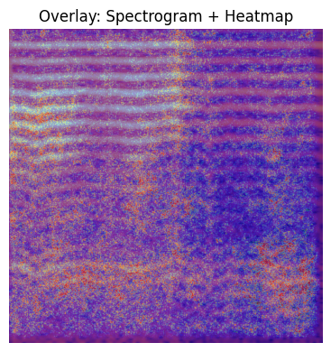
Overlay – Spectrogram + Heatmap
Color interpretation
🔴 / 🟡 (red–yellow): Strong influence on PD prediction
🔵 / 🟣 (blue–purple): Weak or no influence
So wherever bright heatmap colors overlap with abnormal spectrogram patterns,
➡️ those regions convinced the model that the voice is PD.
Red/yellow regions lie exactly on
Broken harmonics
Noise-dominated zones
Pitch instability areas
This alignment means:
Model reasoning matches medical theory
Prediction is not accidental
Decision is physiologically meaningful

Slide 50
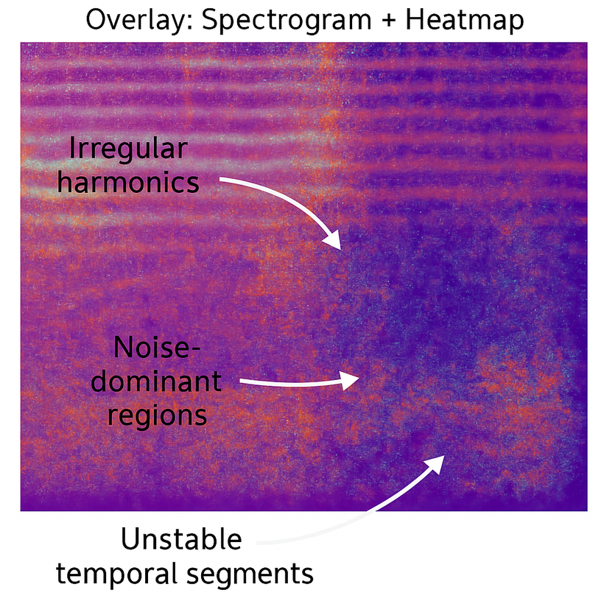
Why the Model Predicts Parkinson’s Disease
Irregular harmonics (top region)
What we see
The horizontal harmonic bands are wavy, broken, and uneven
The heatmap overlaps these distorted bands
What it means physiologically
Harmonics represent regular vibration of vocal folds
In Parkinson’s disease:
Neural motor control is impaired
Vocal fold vibration becomes inconsistent
Pitch tremor appears
Noise-dominant regions (middle–lower region)
What we see
Large areas with grainy, scattered texture
Heatmap highlights these noisy regions strongly
What it means physiologically
Noise dominance = air leakage + poor vocal fold closure
Caused by:
Reduced muscle coordination
Weak control over phonation
Measured acoustically as:
High jitter
High shimmer
Low harmonic-to-noise ratio (HNR)

Slide 51
Unstable temporal segments (time axis behavior)
What we see
Model attention shifts across time
No long segment remains stable
Heatmap activation appears fragmented
What it means physiologically
Parkinson’s patients:
Cannot sustain steady voice output
Experience motor fatigue and tremor
Show fluctuation in loudness and pitch
Any ONE feature alone is not enough
But this image shows ALL THREE simultaneously
This combination is highly characteristic of Parkinson’s disease

Slide 52
Conclusion
Developed a multi-modal Deep Learning–based system for Parkinson’s Disease prediction.
Utilized handwritten spiral, handwritten wave, and voice spectrogram data for comprehensive analysis.
Implemented transfer learning–based CNN models for effective feature extraction and classification.
Integrated Explainable AI (Grad-CAM) across all pipelines to provide visual interpretability.
Enhanced diagnostic transparency and clinical reliability compared to existing approaches.

Slide 53
Future Scope
Extension of the system to include additional modalities such as gait analysis and neuroimaging data.
Development of a unified decision-fusion framework to combine outputs from all pipelines.
Evaluation of the model on larger and clinically diverse datasets to improve generalization.
Deployment as a real-time clinical decision support system for early Parkinson’s detection.
Exploration of advanced Explainable AI techniques for deeper and more detailed model interpretability.

Slide 54
References
[1] S. J. Sharma and R. Gupta, “Deep learning models for predicting cognitive impairment in Parkinson’s disease detection,” in Proc. 2024 IEEE 3rd World Conf. on Applied Intelligence and Computing (AIC), Jul. 2024, pp. 1172–1178.
[2] A. Iyer, A. Kemp, Y. Rahmatallah, L. Pillai, A. Glover, F. Prior, L. Larson-Prior, and T. Virmani, “A machine learning method to process voice samples for identification of Parkinson’s disease”, Scientific Reports, vol. 13, Art. no. 20615, 2023.
[3] M. Shen, P. Mortezaagha, and A. Rahgozar, “Explainable artificial intelligence to diagnose early Parkinson’s disease via voice analysis,” medRxiv, preprint, Sep. 30, 2024.
[4] P. Sridevi, S. Himaja Sri, B. Nandini, M. Bhargavi, and K. Jahnavi, “Early detection of Parkinson’s disease using convolutional neural networks on handwritten patterns,” Mukt Shabd Journal, vol. XIII, no. IV, pp. 1434–1439.
[5] I. Ahmed, S. Aljahdali, M. S. Khan, and S. Kaddoura, “Classification of Parkinson disease based on patient’s voice signal using machine learning,” Intelligent Automation & Soft Computing, vol. 32, no. 2, pp. 705–722, 2022.

Slide 55
[6] D. Xavier, V. Felizardo, B. Ferreira, H. Zacarias, M. Pourvahab, L. Souza-Pereira, and N. M. Garcia, “Voice analysis in Parkinson’s disease: A systematic literature review,” Artificial Intelligence in Medicine, vol. 163, Art. no. 103109, 2025
[7] M. B. Er, E. Isik, and I. Isik, “Parkinson’s detection based on combined CNN and LSTM using enhanced speech signals with variational mode decomposition,” Biomedical Signal Processing and Control, vol. 73, Art. no. 103006, Sep. 2021.
[8] H. G., N. C. R., J. A., and K. K. M., “Prediction of Parkinson’s disease using handwriting analysis and voice dataset: A review,” Journal of Innovative Image Processing, vol. 6, no. 2, pp. 118–132, Jun. 2024.
[9] P. H. C., U. R., and H. Kaur, “Predicting Parkinson’s disease using machine learning with voice parameters and handwriting images,” Journal of Data Science, vol. 2024, Art. no. 19, 2024, eISSN: 2805-5160.

Slide 56
Thank You

